Slide 1
Active Directory—AKA
Active Directory Domain Services
Part 1
Dr John O’Donoghue

Slide 2
Overview
Introduction to Active Directory
Active Directory Logical Structure
Role of DNS in Active Directory
Active Directory Physical Structure
Methods for Administering a Windows 2000 Network
In Windows Server® 2003 and Microsoft Windows® 2000 Server, the directory service is named Active Directory.
In Windows Server 2008 R2 and Windows Server 2008, the directory service is named Active Directory Domain Services. Certain slides herein refer to AD DS, but the information is also applicable to Active Directory.

Slide 3
What is Active Directory (AD DS)
Active Directory is a directory service. It is a container that provides a hierarchical structure and allows a systems administrator to store objects for quick and easy access and manipulation.
A directory service is like an electronic phone directory that lets you search for Name and retrieve the phone number, address, or other information without knowing where that person lives.
Before directory services, If you needed a file, you needed to know the name of the file, the name of the server on which it is stored and its folder path. Now this works well on small network, but as the network grows it becomes challenging.
Directory service is the means by which users and administrators can locate resources regardless of where those resources are located.
Also earlier typical user could have more than one user account or password, and as the network grows and the number of username and password also increases, like one for File Server, one for email server, etc.

Slide 4
What Is Active Directory?
Directory Service
Functionality
Centralized Management
Organize
Manage
Control
Single point of administration
Full user access to directory resources by a single logon
Resources

Slide 5
More than a Directory Service…
Active Directory does a lot more than just locating resources.
Active Directory take care of this by using Kerberos Authentication and Single Sign-On (SSO).
Kerberos is a network authentication protocol. It is designed to provide strong authentication for client/server applications by using secret-key cryptography.
SSO means ability of Kerberos to provide a user with one set of credentials and grant them access across a range of resources and services with that same set of credentials.
  Kerberos authenticates the credentials and issues the user a ticket with which the user gains access to the resources and services that support Kerberos.
Active Directory also makes user management more easier as it acts as a single repository for all of this user and computer related information.

Slide 6
AD uses LDAP and DNS
AD uses LDAP as its access protocol.
  LDAP (Lightweight Directory Access Protocol) is an application protocol for querying and modifying items in directory service providers like Active Directory, which supports a form of LDAP.
AD relies on DNS as its locator service, enabling clients to locate domain controllers through DNS queries.
  Domain Name System (or Service or Server), an Internet service that translates domain names into IP addresses.

Slide 7
Lightweight Directory Access Protocol (LDAP)
LDAP Provides a Way to Communicate with Active Directory by Specifying Unique Naming Paths for Each Object in the Directory
LDAP Naming Paths Include:
  Distinguished names
  Relative distinguished names
Suzan Fine
CN=Suzan Fine,OU=Sales,DC=contoso,DC=msft

Slide 8
DNS and Active Directory Namespaces
DNS Namespace
Internet
“.”
(DNS root domain)
com.
Active Directory Namespace
microsoft
microsoft.com
training
sales
training. microsoft.com
computer1
sales. microsoft.com
= DNS node (domain or computer)
= Active Directory domain

Slide 9
Active Directory
Logical Structure #1

Slide 10



Active Directory Objects
Objects
Active Directory
Printers
Attributes
Printer1
Printer Name
Printer Location
Printer2
Printers
Printer3
Attribute
Value
Users
Attributes
First Name
Last Name
Logon Name
Don Hall
Suzan Fine
Users
    Objects Represent Network Resources
    Attributes Store Information About an Object

Slide 11





Active Directory Schema
Objects
Class Examples
Active Directory Schema Is:
Dynamically Available
Dynamically Updateable
Protected by DACLs
Discretionary Access Control List (DACL)
Attribute
Examples
Computers
Attributes of Users
Might Contain:
List of Attributes
accountExpires
department
distinguishedName
middleName
accountExpires
department
distinguishedName
directReports
dNSHostName
operatingSystem
repsFrom
repsTo
middleName
…
Users
Printers

Slide 12
AD DS Security
All objects in Active Directory, and all securable objects on a local computer or on the network, have security descriptors to help control access to the objects.
Security descriptors include information about who owns an object, who can access it and in what way, and what types of access are audited.
Security descriptors, in turn, contain the access control list (ACL) of an object, which includes all of the security permissions that apply to that object. An object’s security descriptor can contain two types of ACLs:
  A discretionary access control list (DACL) that identifies the users and groups who are allowed or denied access
  A system access control list (SACL) that controls how access is audited

Slide 13
Types of Object
Data stored within Active Directory is presented to the user in a hierarchical fashion similar to the way data is stored in a filesystem.
Each entry is referred to as an object.
At the structural level, there are two types of objects: containers and non-containers.
  Noncontainer objects are also known as leaf nodes. As the name implies, however, a leaf node may not contain any other objects.
One or more containers branch off in a hierarchical fashion from a root container. Each container may contain leaf nodes or other containers.

Slide 14
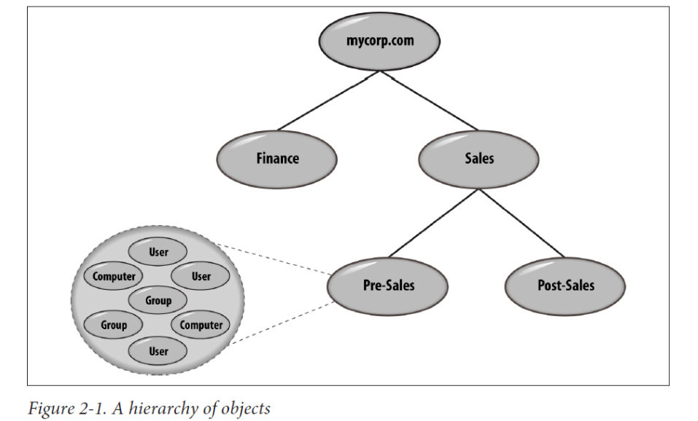
Parent-child Object relationships
The root of this tree has two children, Finance and Sales. Both of these are containers of other objects. Sales has two children of its own, Pre-Sales and Post-Sales. Only the Pre- Sales container is shown as containing additional child objects. The Pre-Sales container holds user, group, and computer objects as an example.
Each of these child nodes is said to have the Pre-Sales container as its parent. Figure 2-1 represents what is known in Active Directory as a domain.
The most common type of container you will create in Active Directory is an organizational unit (OU), but there are others as well, such as the type called “container.”

Slide 15
Uniquely Identifying Objects
When you are potentially storing millions of objects in Active Directory
Each object has to be uniquely locatable and identifiable.
To that end, objects have a globally unique identifier (GUID) assigned to them by the system at creation.
This 128-bit number is the Microsoft implementation of the universally unique identifier (UUID) concept from Digital Equipment Corporation.

Slide 16
GUID and DN
The object’s GUID stays with the object until it is deleted, regardless of whether it is renamed or moved within the directory information tree (DIT).
The object’s GUID will also be preserved if you move an object between domains within a multidomain forest.
Another way to reference objects, called a distinguished name (DN), is more commonly used

Slide 17
Distinguished Names
Hierarchical paths in Active Directory are known as distinguished names and can be used to uniquely reference an object.
  Defined in the LDAP standard as a means of referring to any object in the directory.
DN for Active Directory objects are normally represented using the syntax and rules defined in the LDAP standards.
dc=mycorp,dc=com
  dc stands for domain component and is used to specify domain or application partition objects.

Slide 18
RDN
A relative distinguished name (RDN) is the name used to uniquely reference an object within its parent container in the directory.
  For example, this is the DN for the default Administrator account in the Users container in the mycorp.com domain:
  cn=Administrator,cn=Users,dc=mycorp,dc=com
This is the RDN of the user: cn=Administrator
  Any object class that does not have a specific letter code uses the default of cn, which stands for common name.

Slide 19
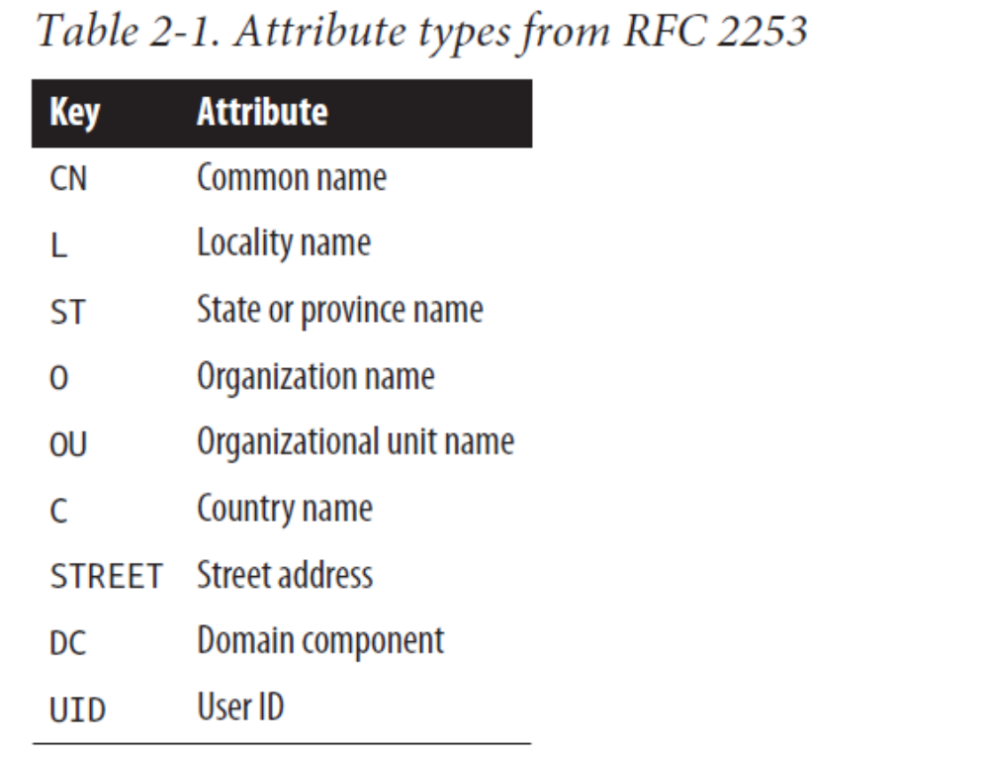
Attribute Types
Table 2-1 provides a complete list of the most common attribute
types amongst directory server implementations. The list is from RFC 2253, “Lightweight Directory Access Protocol”.
Notes:
RFC: https://www.ietf.org/rfc.html
RFC: 2253: https://datatracker.ietf.org/doc/rfc2253/

Slide 20
Example
If all the containers were organizational units, the distinguished names for Pre-Sales and Post-Sales would be as follows:
  ou=Pre-Sales,ou=Sales,dc=mycorp,dc=com
  ou=Post-Sales,ou=Sales,dc=mycorp,dc=com
And if you wanted to specify a user named Richard Lang, a group called My Group, and a computer called PC1 in the Pre-Sales OU, you would use the following:
  cn=Richard Lang,ou=Pre-Sales,ou=Sales,dc=mycorp,dc=com
  cn=My Group,ou=Pre-Sales,ou=Sales,dc=mycorp,dc=com
  cn=PC1,ou=Pre-Sales,ou=Sales,dc=mycorp,dc=com

Slide 21
Active Directory
Logical Structure #2
Domains
Organizational Units
Trees and Forests
Global Catalog

Slide 22
Domains and Domain Trees
Active Directory’s logical structure is built around the concept of domains. It is…
  An X.500-based hierarchical structure of containers and objects
  A DNS domain name as a unique identifier
  A security service, which authenticates and authorizes any access to resources via accounts in the domain or trusts with other domains
  Policies that dictate how functionality is restricted for users or machines within that domain
Notes:
Wiki: X.500 is a series of computer networking standards covering electronic directory services. The X.500 series was developed by ITU-T, formerly known as CCITT, and first approved in 1988.^{[1]} The directory services were developed in order to support the requirements of X.400 electronic mail exchange and name lookup. ISO was a partner in developing the standards, incorporating them into the Open Systems Interconnection suite of protocols. ISO/IEC 9594 is the corresponding ISO identification.

Slide 23
Domains
A Domain Is a Security Boundary
  A domain administrator can administer only within the domain, unless explicitly granted administration rights in other domains
A Domain Is a Unit of Replication
  Domain controllers in a domain participate in replication and contain a complete copy of the directory information for their domain
Windows 2012
Domain
Replication
User1
User2
User1
User2

Slide 24
Domains and Controllers
A domain controller (DC) can be authoritative for one and only one domain.
  It is not possible to host multiple domains on a single DC.
  For example, Mycorp has already been allocated a DNS domain name for its company called mycorp.com, so it decides that the first Active Directory domain that it is going to build is to be named mycorp.com. However, this is only the first domain in a series that may need to be created, and mycorp.com is in fact the root of a domain tree.
The mycorp.com domain itself, ignoring its contents, is automatically created as the root node of a hierarchical structure called a domain tree.
This is literally a series of domains connected together in a hierarchical fashion, all using a contiguous naming scheme.
If Mycorp were to add domains called Europe, Asia, and Americas, then the names would be europe.mycorp.com, asia.mycorp.com, and americas.mycorp.com.
Each domain tree is called by the name given to the root of the tree; hence, this domain tree is known as the mycorp.com tree,

Slide 25
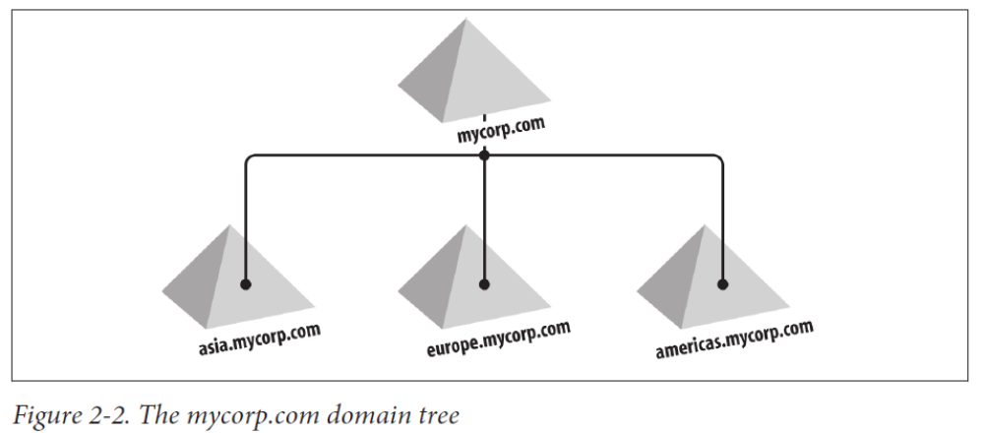
Domain Tree
All Domains in a Tree share:
Schema
Configuration
Global Catalog
Trees ease management and access to resources, as all the domains in a domain tree trust one another implicitly with transitive trusts.
In a transitive trust, if Domain A trusts Domain B and Domain B trusts Domain C, his implies that Domain A trusts Domain C as well.

Slide 26
What Is a Tree?
Parent
Tree Root Domain
Parent Domain
contoso.msft
Child
Child Domain
sales.contoso.msft
New
Domain
Contiguous Namespace
sales.contoso.msft

Slide 27
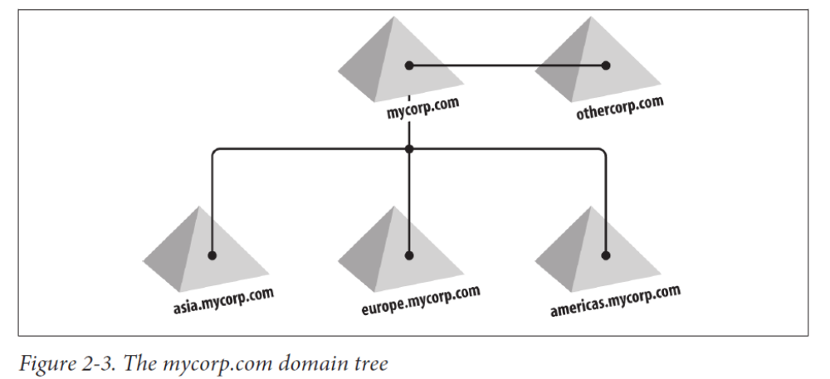
Trusts, Trees and Forests
Trust relationships do not compromise security; they are just setting up the potential to allow access to resources.
Actual access permissions still have to be granted by administrators.
This is why you should avoid granting access to Everyone or Authenticated Users on resources.
Once a trust is established, everyone in the trusted domain will be able to access those resources as well.

Slide 28
Trees and Forests
contoso.msft
(root)
Two-Way Transitive Trust
nwtraders.msft
Forest
asia.
contoso.msft
au.
contoso.msft
Tree
asia.
nwtraders.msft
au.
nwtraders.msft
Two-Way Transitive Trusts
Tree

Slide 29
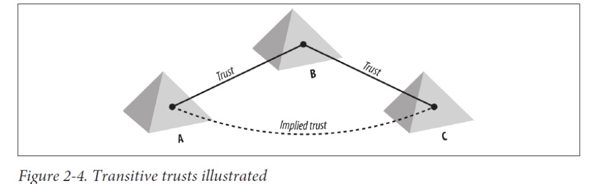
Forests
Where a domain tree was a collection of domains, a forest is a collection of one or more domain trees.
These domain trees share a common Schema and Configuration container, and the trees as a whole are connected together through transitive trusts.
As soon as you create a single domain, you have a forest.
If you add any domains to the initial domain tree or add new domain trees, you still have one forest.

Slide 30


What Is a Forest?
A Forest is One or More Trees
Trees in a Forest Do Not Share a Contiguous Namespace
contoso.msft
Forest
nwtraders.msft
Tree
sales.
contoso.msft
marketing.
nwtraders.msft
Tree
sales.
nwtraders.msft
All of The Domains in a Forest Share a Common Configuration, Schema, and Global Catalog

Slide 31
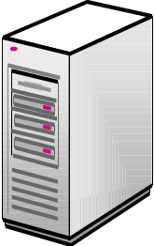



What Is the Forest Root Domain?
The Forest Root Domain Is
the First Domain Created
in a Forest
contoso.msft
Forest Root Domain
Global Catalog
Forest
nwtraders.msft
Configuration
and Schema
Tree Root Domain
Tree
Tree
Enterprise Admins
marketing.nwtraders.msft
Schema Admins
sales.contoso.msft

Slide 32
Some advice on Forests
While multiple domain trees in a forest can be configured, you should seriously consider all the implications of such a configuration before implementation.
It can be confusing for troubleshooting efforts when you are working on an issue in the domain othercorp.com, but the configuration information for the forest is maintained in the partition cn=configuration,dc=mycorp,dc=com.
This is especially true when bringing in outside resources not familiar with the implementation.
While legitimate reasons exist to create multitree forests, we recommend that you endeavor to simplify your Active Directory design as much as possible and limit yourself to one domain tree and as few domains as possible.
Best practice for new forest designs is almost always a single-domain forest.

Slide 33
More advice…
If you have business units that are independent and, in fact, wish to be isolated from each other, then you must not combine them in a single forest.
If you simply give each business unit its own domain, these business units are given the impression that they are autonomous and isolated from each other.
However, in Active Directory, this level of autonomy and isolation can be achieved only through separate forests. This is also the case if you need to comply with regulatory or legal isolation requirements.
Finally, some organizations choose to deploy Microsoft Exchange in a separate resource forest in order to handle separate administrative structures and requirements.

Slide 34
Organizational Units
Containers within Domains
Distinct Units of Administration
Unique to Domains
The primary type of container that you will create to house objects is called an organizational unit (OU).
Another type of container, which is actually called a container, can also be used to store a hierarchy of objects and containers.
Although both can contain huge hierarchies of containers and objects, an organizational unit can have group policies applied to it.
For this reason, OUs are often used almost exclusively for building object hierarchies within a domain.
Notes:
KEY MESSAGE: Describe Organizational Units
SLIDE BUILDS: None
SLIDE SCRIPT:
Organizational Units – or OUs – are containers that are used to organize objects within a Domain. For example, OUs can contain Users, Computers, Groups, Printers, File Shares and other OUs. OUs can be logically structured into a hierarchy that models the business.
They are distinct logical administrative units that can be used to:
1.) delegate administration within a domain.
2.) apply policies to objects (such as Users or Computers) as a group.
The OU hierarchy within a particular Domain is independent of the OU hierarchy in any other Domain. Each Domain can implement its own OU hierarchy. OUs are represented by circles within a Domain.
SLIDE TRANSITION:
ADDITIONAL INFORMATION FOR PRESENTER:

Slide 35
Organizational Units
Network Administrative Model
Organizational Structure
Sales
Vancouver
Users
Sales
Computers
Repair
Use OUs to Group Objects into a Logical Hierarchy That Best Suits the Needs of Your Organization
Delegate Administrative Control over the Objects Within an OU by Assigning Specific Permissions to Users and Groups

Slide 36


